Slide 1


+
Software project bidding report
汇报人：殷鹏飞

Slide 2

01
Personnel of both side
目
录
02
Introduce our technique capability
CONTENT
+
03
Introduce our project experience
04
Help customes focus on our software

Slide 3

01
Personnel of both side

Slide 4

₊
Personnel of both side
I'm Gary from action software company.
I'll introduce the advantages of our company in completing this project.

Slide 5
02
Introduce our technique capability

Slide 6

our technique capability
We have a good command of the mainstream software development technology in the current market.
◎ SQL server database
◎ dynamic page technology of customer end
◎ the web framework technology
◎ ...

Slide 7
03
Introduce our project experience

Slide 8

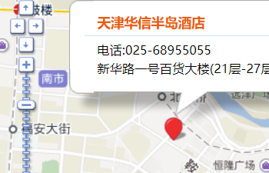
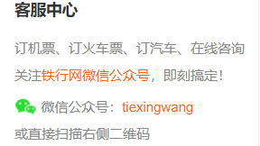
We have relevant project experience
Our team have already developed an online train ticket purchase system, which can query train information, online payment, seat selection, ticket refund and other functions.

Slide 9

Experience in
developing Film Ticketing System
Our team has also developed a film ticketing system to realize the online ticketing function, and users can enter the cinema without taking paper tickets and scanning codes.

Slide 10
04
Help customers focus on our software

Slide 11

+
Consider user experience
Our team has done a lot of preparation work.
We conducted a large number of pre-launch usage surveys, and users suggested what they felt was inappropriate.

Slide 12

THANK YOU

